Slide 1



YOGA CLUB SOCIETY
EXCO MEETING
AGENDA
Friday, 11 September 2026
7:00 p.m., Google Meet
SUNGAI LONG CAMPUS
Notes:
Content source: Yoga Club EXCO Meeting Agenda – 11 September 2026.md, meeting header. Visual language and embedded imagery reference: 1nd EXCO proposal meeting 2026.pptx.

Slide 2
UTAR SL YOGA CLUB
01
Decisions required at this meeting
PROGRAMME
Confirm compulsory activities and select the proposed trials for the next semester.
OCTOBER RD
Approve the promotion offer, Members’ Night link and Vice Treasurer recruitment message.
GOVERNANCE
Agree proposal, reporting, finance, attendance and publicity controls.
PEOPLE
Confirm certification rules, signatories and committee recruitment priorities.
RESOURCES
Shortlist merchandise and determine which activities require budget approval.
Meeting discipline
Record every decision with an owner and due date before the meeting closes.
EXCO MEETING, 11 SEPTEMBER 2026
2
Notes:
Content source: Yoga Club EXCO Meeting Agenda – 11 September 2026.md, overview of Items 1–12. Visual language and embedded imagery reference: 1nd EXCO proposal meeting 2026.pptx.

Slide 3

UTAR SL YOGA CLUB
02
Next semester activity plan
COMPULSORY PROGRAMME
Recruitment Drive
Weekly yoga classes
Free yoga classes
OPTIONS FOR REVIEW
Members’ Night as a reward for regular participants
One or two meditation sessions, free or paid
Natural Yoga pilot next semester or from February 2027
6–8
additional practical sessions during a long semester, scheduled around common free hours and certification needs
EXCO MEETING, 11 SEPTEMBER 2026
3
Notes:
Content source: Yoga Club EXCO Meeting Agenda – 11 September 2026.md, Item 1. Visual language and embedded imagery reference: 1nd EXCO proposal meeting 2026.pptx.

Slide 4

UTAR SL YOGA CLUB
03
October Recruitment Drive
PROMOTION CONTENT
Club merchandise and lucky draw
Weekly-class certification
Members’ Night after the October free class, if confirmed
OFFERS AND RECRUITMENT
Review a free first class for first-time participants
Review fee waivers for members who bring new participants
Recruit the vacant Vice Treasurer during the drive
Collect participant and member feedback after the activity
EXCO MEETING, 11 SEPTEMBER 2026
4
Notes:
Content source: Yoga Club EXCO Meeting Agenda – 11 September 2026.md, Item 2. Visual language and embedded imagery reference: 1nd EXCO proposal meeting 2026.pptx.

Slide 5
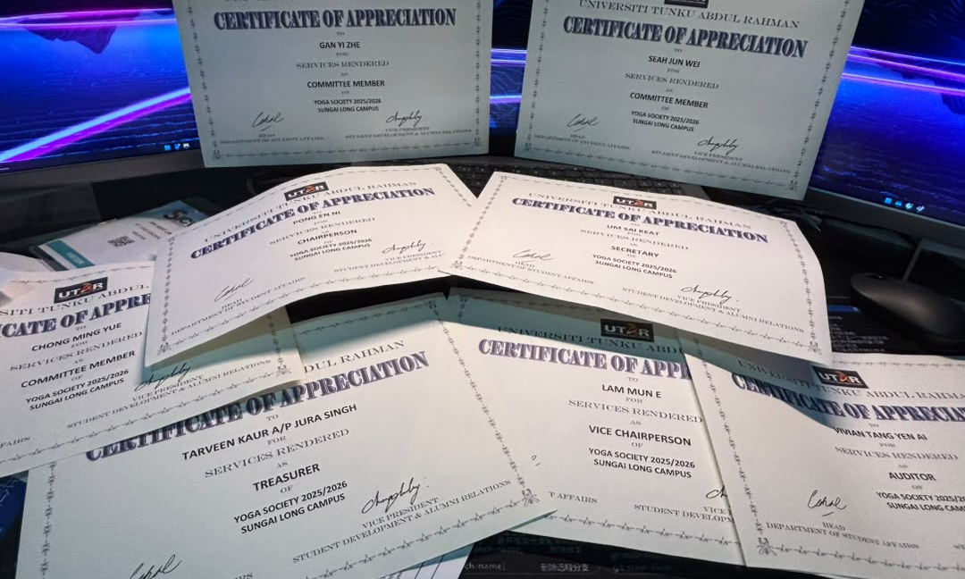
UTAR SL YOGA CLUB
04
Secretarial deliverables and records
BEFORE EACH ACTIVITY
Prepare one proposal for every activity where required
Cover objectives, schedule, venue, budget, publicity, registration and approvals
Submit before the activity and within the required timeline
BY WEEK 14
Complete reports for weekly classes, the Recruitment Drive, both EXCO meetings and the free yoga class
Include Office Bearers and any other reportable activities or matters
CONTROL RECORD
Maintain a completed and outstanding checklist
Record student coach service hours and attendance
Review whether the club website can support traceability
EXCO MEETING, 11 SEPTEMBER 2026
5
Notes:
Content source: Yoga Club EXCO Meeting Agenda – 11 September 2026.md, Item 3; obvious source typo ‘Office Barriers’ normalised to ‘Office Bearers’. Visual language and embedded imagery reference: 1nd EXCO proposal meeting 2026.pptx.

Slide 6

UTAR SL YOGA CLUB
05
Treasury policy and documentation
Establish a treasury policy and supporting documentation for every event
Maintain complete financial records for events and weekly classes
Pass confirmed financial arrangements to the Secretary and Publicity team
Publicity prepares pricing announcements after verification
The Secretary records the arrangements in proposals and reports
Fee tracking and unified receipt upload functions already exist on the proposed website and are not urgent
EXCO MEETING, 11 SEPTEMBER 2026
6
Notes:
Content source: Yoga Club EXCO Meeting Agenda – 11 September 2026.md, Item 4. Visual language and embedded imagery reference: 1nd EXCO proposal meeting 2026.pptx.

Slide 7

UTAR SL YOGA CLUB
06
Student Instructor Programme
ELIGIBILITY
More than two semester-based Certificates of Completion
Or one yearly Certificate of Completion if the yearly system is adopted
Semester certificates apply only to long semesters of about 14 weeks
BENEFIT UNDER REVIEW
Fee waiver for student instructors who maintain more than 80% class attendance
PROPOSED SIGNATORIES
Instructor Ms Chew, Club Auditor, Club Chairperson, and Ms Belinda, Ms Heng or Core Advisor
EXCO MEETING, 11 SEPTEMBER 2026
7
Notes:
Content source: Yoga Club EXCO Meeting Agenda – 11 September 2026.md, Item 5. Visual language and embedded imagery reference: 1nd EXCO proposal meeting 2026.pptx.

Slide 8

UTAR SL YOGA CLUB
07
Publicity guidelines and controls
PUBLICATION SCOPE
Recruitment Drive and free yoga classes
Weekly classes and certification
Members’ Night, lucky draw and merchandise
Meditation and other approved programmes
RELEASE CONTROL
Verify dates, venues, fees, payment instructions and participation requirements with the Secretary and Treasurer
Update materials when confirmed arrangements change
Archive posters, captions, announcements and registration links
EXCO MEETING, 11 SEPTEMBER 2026
8
Notes:
Content source: Yoga Club EXCO Meeting Agenda – 11 September 2026.md, Item 6. Visual language and embedded imagery reference: 1nd EXCO proposal meeting 2026.pptx.

Slide 9
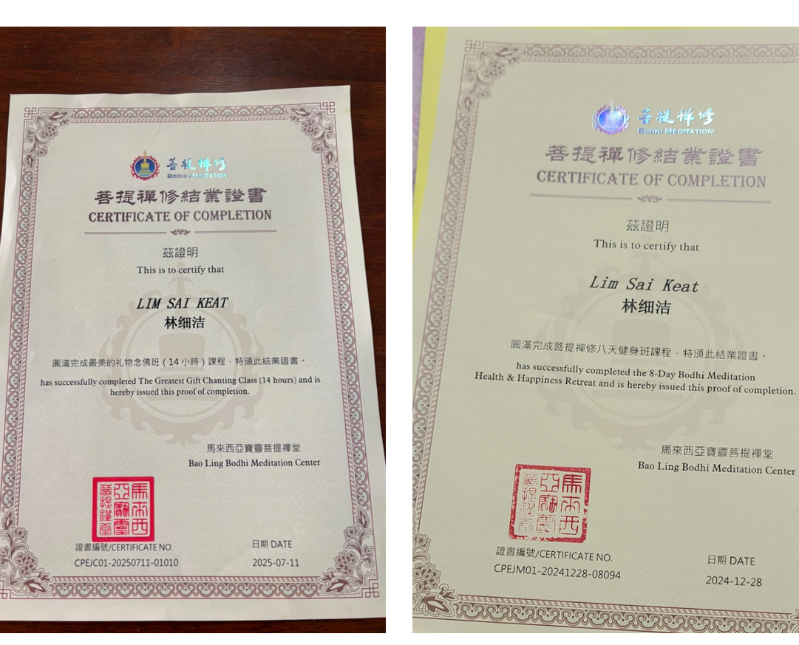
UTAR SL YOGA CLUB
08
Weekly class certification policy
80%
proposed attendance threshold for a semester-based Certificate of Completion (结业证书)
SEMESTER MODEL
Approximately 14 hours or 14 class days during a long semester
Short-semester attendance may accumulate towards the long-semester requirement
ALTERNATIVE YEARLY MODEL
STILL TO CONFIRM
Approximately 35 hours, 35 days or 35 yoga practice classes
Authorised signatories and permitted Yoga Club, DSA and UTAR logos
EXCO MEETING, 11 SEPTEMBER 2026
9
Notes:
Content source: Yoga Club EXCO Meeting Agenda – 11 September 2026.md, Item 7. Visual language and embedded imagery reference: 1nd EXCO proposal meeting 2026.pptx.

Slide 10
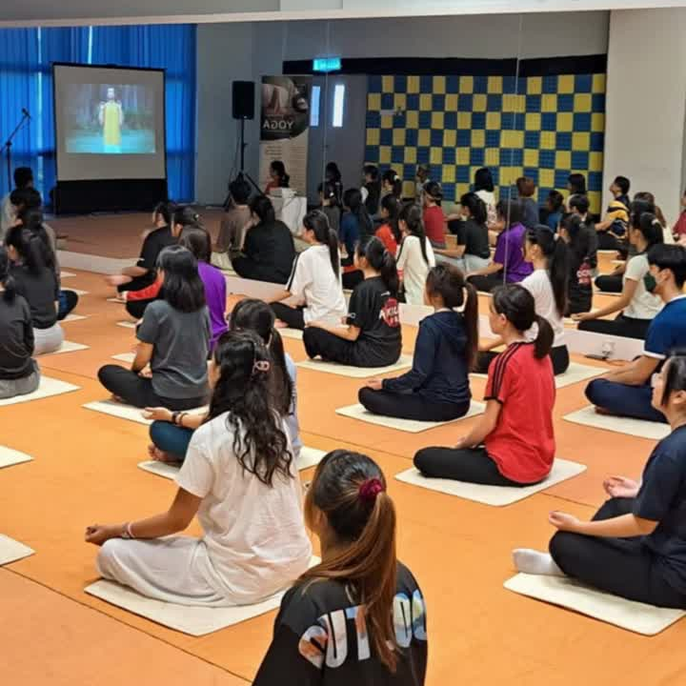
UTAR SL YOGA CLUB
09
Higher committee recruitment
PRIORITY VACANCIES
VICE CHAIRPERSON
Identify a suitable current committee member with a strong student network.
PUBLICITY TEAM
Recruit one additional member to support the coming programme.
RECRUITMENT ROUTE
Committee referrals and suitable EA appointments for experience-based instructor, committee and event-support roles
EXCO MEETING, 11 SEPTEMBER 2026
10
Notes:
Content source: Yoga Club EXCO Meeting Agenda – 11 September 2026.md, Item 8. Visual language and embedded imagery reference: 1nd EXCO proposal meeting 2026.pptx.

Slide 11

UTAR SL YOGA CLUB
10
New Yoga Club merchandise
HIGHER-END
Logo cape or cloak, yoga mat, yoga bricks
MIDDLE-RANGE
Yoga brick, T-shirt, hat, stretching strap
LOWER-COST
Keychain, lanyard, rubber wristband, other suitable small items
Decision
Every committee member selects at least three preferred items. Publicity designs the shortlist, the Secretary updates the proposal and the Treasurer confirms supplier pricing and pre-funding.
EXCO MEETING, 11 SEPTEMBER 2026
11
Notes:
Content source: Yoga Club EXCO Meeting Agenda – 11 September 2026.md, Item 9. Visual language and embedded imagery reference: 1nd EXCO proposal meeting 2026.pptx.

Slide 12
UTAR SL YOGA CLUB
11
Members’ Night and lucky draw
PURPOSE
Recognise regular June-class participants and welcome new club members.
BUDGET CONDITION
Club funding for the lucky draw requires budget review and approval before commitment.
POSSIBLE MEMBER BENEFITS
Free food or health-oriented gifts
Selected club merchandise in the lucky draw pool
Feedback survey and promotion of upcoming yoga classes
EXCO MEETING, 11 SEPTEMBER 2026
12
Notes:
Content source: Yoga Club EXCO Meeting Agenda – 11 September 2026.md, Items 2.3 and 10. Visual language and embedded imagery reference: 1nd EXCO proposal meeting 2026.pptx.

Slide 13
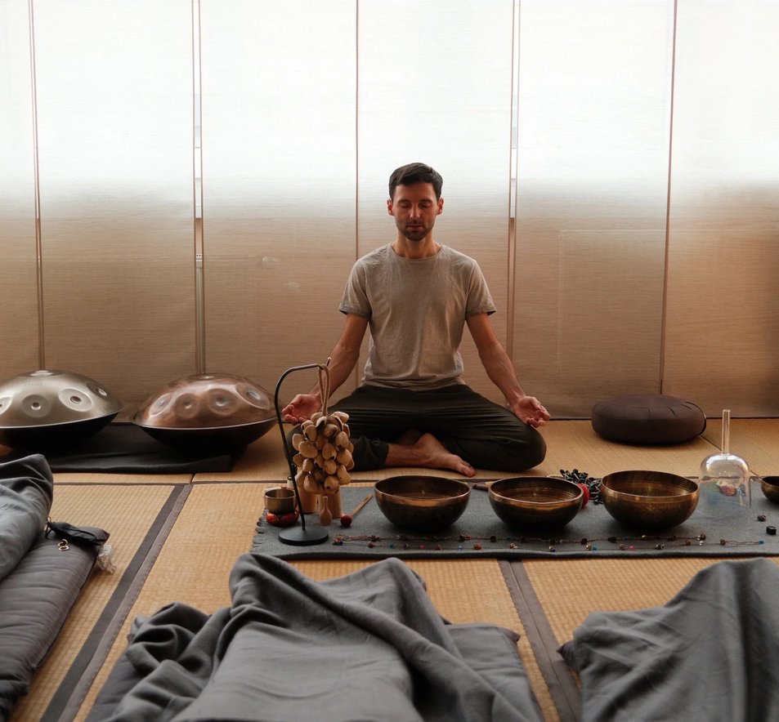
UTAR SL YOGA CLUB
12
Meditation and practice-class pilot
PILOT FORMAT
Meditation, additional yoga practice, or both
One selected day or a weekly format
Potentially delivered fully by student instructors
Location and participation fee remain to be confirmed
SERVICE CERTIFICATION
Yearly certificates may record the number of events, total service hours and the individual’s role in instruction, organisation or publicity.
EXCO MEETING, 11 SEPTEMBER 2026
13
Notes:
Content source: Yoga Club EXCO Meeting Agenda – 11 September 2026.md, Item 12. Visual language and embedded imagery reference: 1nd EXCO proposal meeting 2026.pptx.

Slide 14
UTAR SL YOGA CLUB
13
Open matters and governance checks
YOGA DAY
Consult Ms Belinda on information and approval requirements for a larger-scale event.
ATTENDANCE
Agree an improved recording method for weekly classes and other activities.
WEBSITE
Determine which record, fee and receipt functions should move into the proposed club website.
COVERAGE
Identify any additional activity, meeting or matter requiring a proposal or semester report.
FEEDBACK
Invite final suggestions and unresolved departmental concerns.
EXCO MEETING, 11 SEPTEMBER 2026
14
Notes:
Content source: Yoga Club EXCO Meeting Agenda – 11 September 2026.md, Items 3.9–3.12 and 11. Visual language and embedded imagery reference: 1nd EXCO proposal meeting 2026.pptx.

Slide 15
BEFORE WE CLOSE
Confirm the decision,
owner and due date
Secretary updates the proposal and report checklist
Departments verify their assigned actions
Any approval dependency is recorded explicitly
Meeting minutes capture the final decisions
UTAR SL YOGA CLUB, SUNGAI LONG CAMPUS
Notes:
Content source: Yoga Club EXCO Meeting Agenda – 11 September 2026.md, meeting close and action-recording requirement derived from Items 3, 4, 6 and 11. Visual language and embedded imagery reference: 1nd EXCO proposal meeting 2026.pptx.

